Slide 1

CORONA - VIRUS
Analysis
-By Ranjitha H S

Slide 2
Objective of the Project :
The objective of coronavirus analysis is to monitor how COVID-19 spreads and affects people by looking at data on cases, recoveries, and and deaths deaths in differe different areas over time. This includes:
Monitor Pandemic Trends: Analyze confirmed cases, recoveries, and deaths over time to understand the progression and severity of COVID-19.
Geographical Spread Analysis: Use latitude and longitude data to visualize and track the regional and global spread of the virus.
Trend & Pattern Identification: Identify growth patterns, peak periods, recovery rates, and regional variations through time-series analysis.
Forecasting & Impact Assessment: Apply analytical and predictive models to estimate future case trends and compare the pandemic’s impact across different regions.

Slide 3
Dataset Source
The dataset appears to be a COVID-19 dataset, providing detailed information about the progression of the pandemic. Here are the key features and their descriptions:
Province: The province or state within the country.
Country/Region: The country or region where the data was recorded.
Latitude: Latitude coordinate for the location.
Longitude: Longitude coordinate for the location.
Date: The date when the data was recorded.
Confirmed: The number of confirmed COVID-19 cases.
Deaths: The number of deaths due to COVID-19.
Recovered: The number of recovered cases from COVID-19

Slide 4

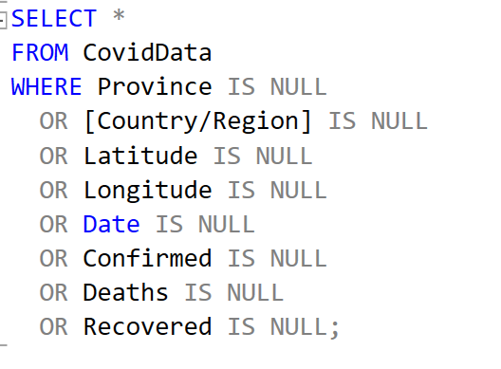
QUESTION - 01
Corona Virus Analysis
Write a code to check NULL values.
•There are no null values in given dataset.
– By Ranjitha H S

Slide 5
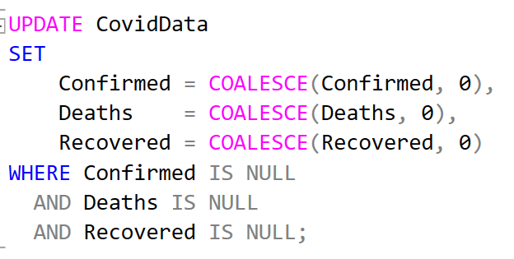
QUESTION - 02
Corona Virus Analysis
If NULL values are present, update them with zeros for all columns.
•There are no null values in given dataset.
– By Ranjitha H S

Slide 6
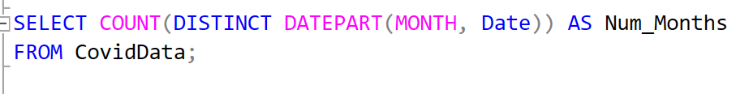

QUESTION - 03
Corona Virus Analysis
Number of month present in dataset.
– By Ranjitha H S

Slide 7


QUESTION - 04
Corona Virus Analysis
Check total number of rows.
– By Ranjitha H S

Slide 8
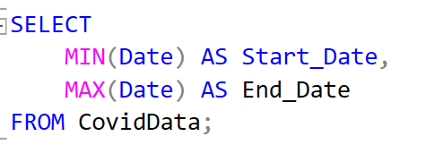

QUESTION - 05
Corona Virus Analysis
Check what is start date and end date.
– By Ranjitha H S

Slide 9
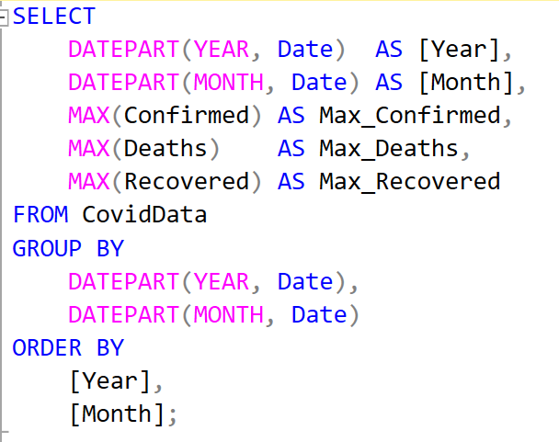
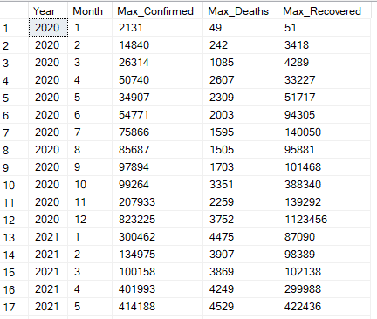
QUESTION - 06
Corona Virus Analysis
Find most frequent value for confirmed, deaths, recovered each month
– By Ranjitha H S

Slide 10
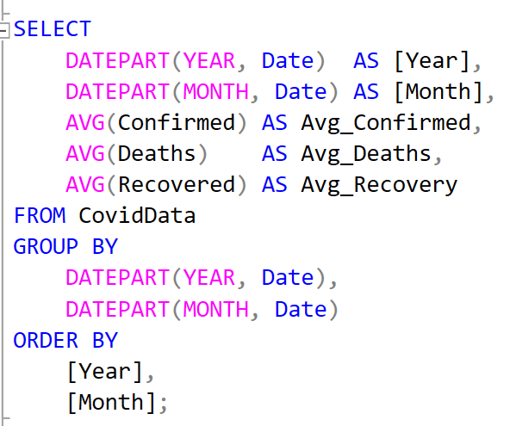
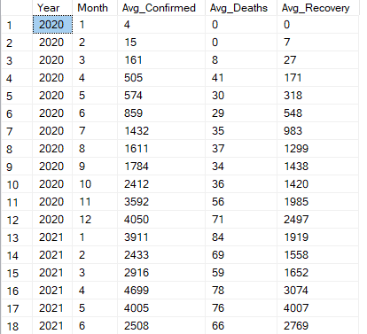
QUESTION - 07
Corona Virus Analysis
Find monthly average for confirmed, deaths, recovered.
– By Ranjitha H S

Slide 11
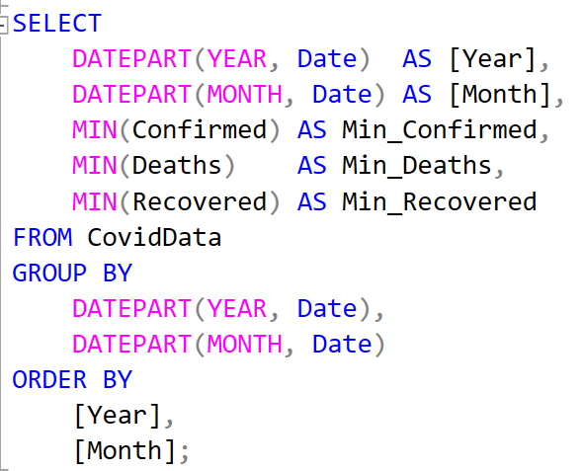
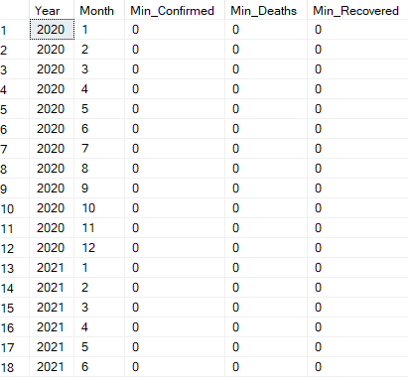
QUESTION - 08
Corona Virus Analysis
Find minimum values for confirmed, deaths, recovered per year
– By Ranjitha H S

Slide 12
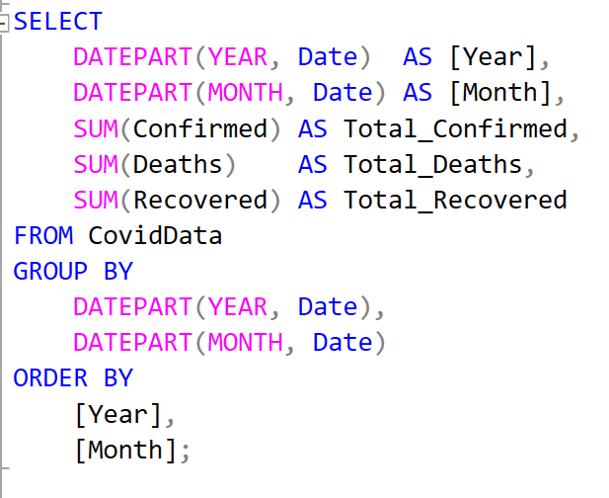
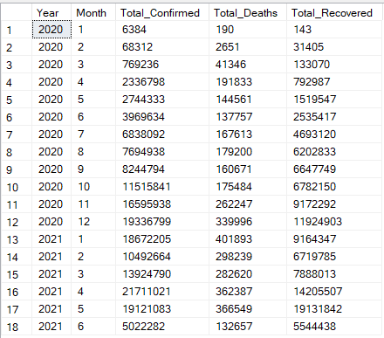
QUESTION - 09
Corona Virus Analysis
Total Confirmed, Deaths & Recovered Cases across months
– By Ranjitha H S

Slide 13
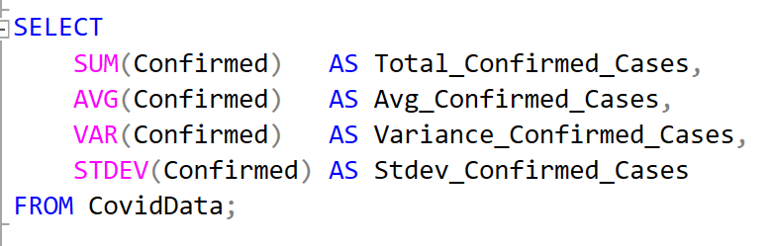
QUESTION - 10
Corona Virus Analysis
Check how corona virus spread out with respect to confirmed case
(Eg.: total confirmed cases, their average, variance & STDEV)

Slide 14
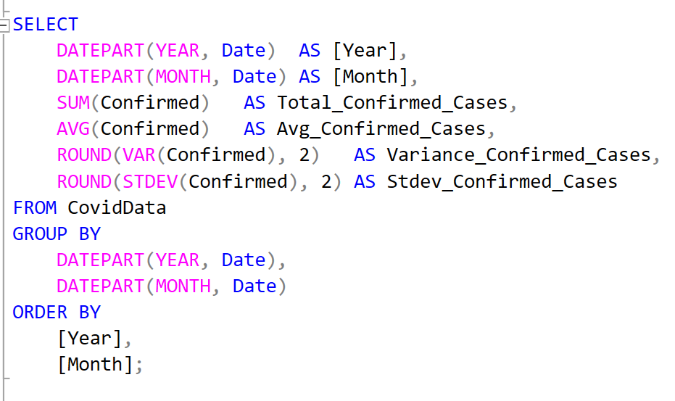
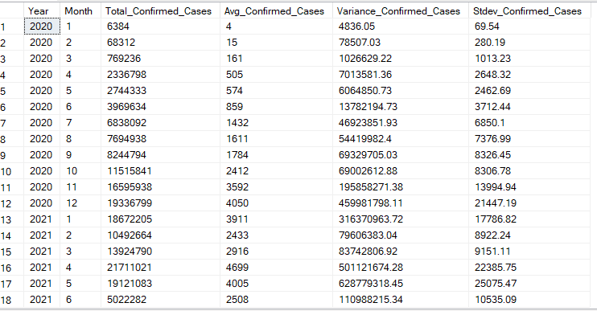
QUESTION - 11
Corona Virus Analysis
Check how corona virus spread out with respect to Confirmed case per month Eg.: total confirmed cases, their average, variance & STDEV)

Slide 15
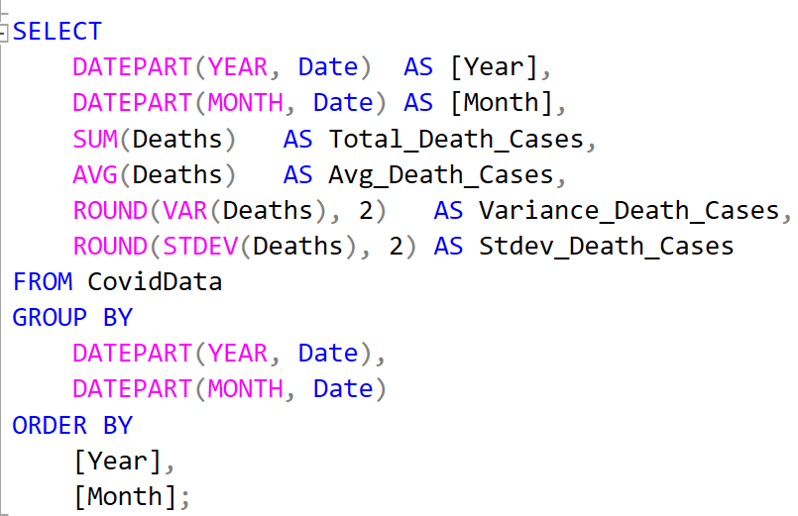
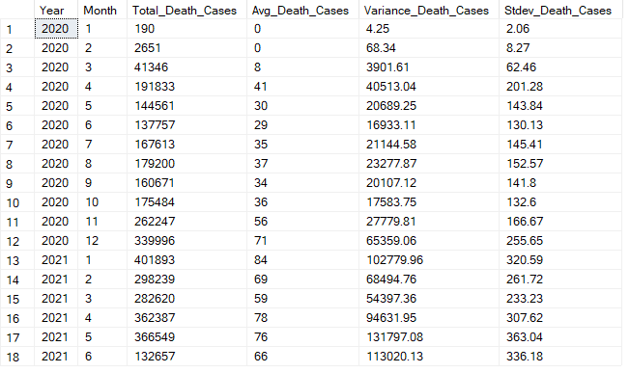
QUESTION - 12
Corona Virus Analysis
Check how corona virus spread out with respect to Death case per month Eg.: total confirmed cases, their average, variance & STDEV)

Slide 16
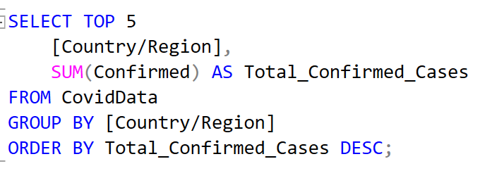
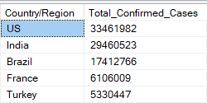
QUESTION - 13
Corona Virus Analysis
Find Country having highest number of the Confirmed case.

Slide 17
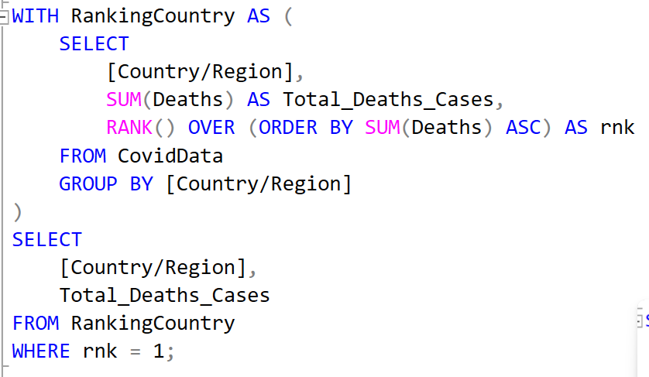
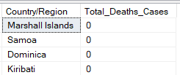
QUESTION - 14
Corona Virus Analysis
Country having lowest number of the death case

Slide 18
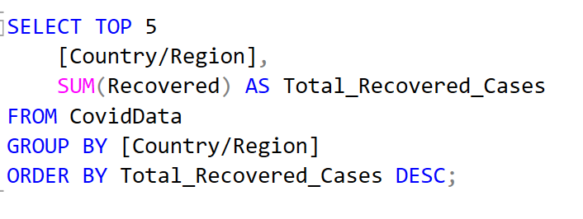
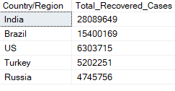
QUESTION - 15
Corona Virus Analysis
Find top 5 countries having highest recovered case

Slide 19

